Slide 1
Computer Graphics
Computer Graphics, Saroj Shakya, Nepal College of Information Technology, Balkumari
‹#›
Notes:
‹#›

Slide 2
Computer Graphics
A field related to the generation of graphics using computers
- It includes the creation, storage and manipulation of images of objects.
Until early 1980’s it was a small specialized field
Hardware was expensive
Graphics based application programs that were easy to use and cost effective were few
PCs with built in raster graphics displays such as the Xerox Star, Apple Macintosh and the IBM PC – popularized the use of bitmap graphics for user computer interaction.
A bitmap is a 1 and 0s representation of the rectangular array of points on the screen.
- Each point is called a pixel, short for “picture elements”.
Computer Graphics, Saroj Shakya, Nepal College of Information Technology, Balkumari
‹#›
Notes:
‹#›

Slide 3
Computer Graphics
Once the bitmap graphics became affordable an explosion of easy to use, inexpensive graphics based user interfaces allowed millions of new users to control simple low cost application programs such as word processors, spreadsheets and drawing programs
The concept of a “desktop” now became popular metaphor for organizing screen space.
Even people who do not use computers encounter computer graphics in TV commercials and as cinematic special effects.
Computer Graphics, Saroj Shakya, Nepal College of Information Technology, Balkumari
‹#›

Slide 4
Computer Graphics
Thus computer graphics is an integral part of all computer user interfaces, and is indispensable for visualizing 2D, 3D objects in all most all areas such as education , science , engineering, medicine, commerce the military advertizing and entertainment.
The theme is that learning how to program and use computers now includes learning how to use simple 2D graphics
Computer Graphics, Saroj Shakya, Nepal College of Information Technology, Balkumari
‹#›

Slide 5
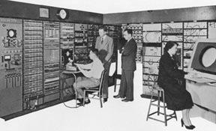
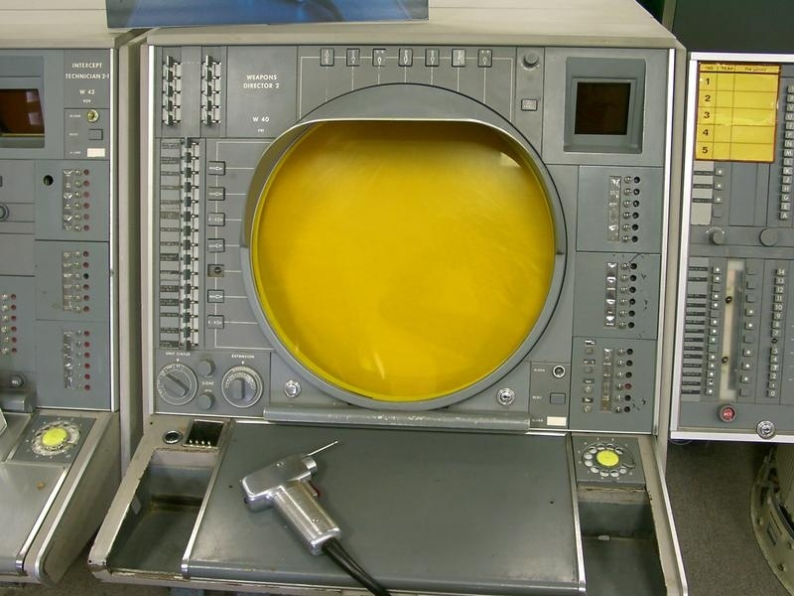
Early History of Computer Graphics
Crude plotting of hardcopy devices such as teletypes and line printers dates from the early days of computing
The whirlwind computer developed in 1950 at the Massachusetts Institute of Technology (MIT) had computer driven CRT displays for output.
Computer Graphics, Saroj Shakya, Nepal College of Information Technology, Balkumari
‹#›

Slide 6
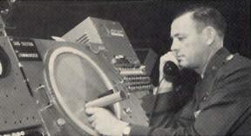
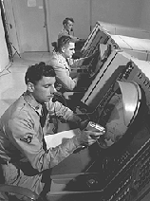
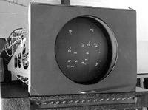
Early History of Computer Graphics
SAGE air-defense system developed in the middle 1950s was the first to use command and control CRT display consoles on which operators identified targets with light pens
(hand held pointing devices that sense light emitted by objects on the screen)
The General Motors DAC system for automobile design and the Itek-Digitek system for lens design
Computer Graphics, Saroj Shakya, Nepal College of Information Technology, Balkumari
‹#›

Slide 7
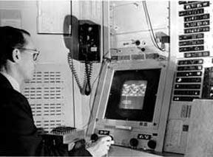
Early History of Computer Graphics
Later on Sketchpad system by Ivan Sutherland came in light.
- The beginning of modern interactive graphics.
- Keyboard and light pen used for pointing, making choices drawing.
Prospects of the use of (CAD) and (CAM) in computer, automobile, and aerospace manufacturing Drafting and Drawing activities.
By the mid 60s, a number of commercial products using these systems had appeared
Computer Graphics, Saroj Shakya, Nepal College of Information Technology, Balkumari
‹#›

Slide 8
Early History
At that time only the most technology intensive organizations could use the interactive computer graphics where as others used punch cards, a non-interactive system .
Reasons:
The high cost of graphics hardware – at a time when automobiles cost a few thousand dollars, computers cost several millions of dollars, and the first commercial computer displays cost more than a hundred thousand dollars
The need for large scale expensive computing resources to support massive design database
The difficulty of writing large interactive programs using batch oriented FORTRAN programming
Computer Graphics, Saroj Shakya, Nepal College of Information Technology, Balkumari
‹#›

Slide 9
Early History of Computer Graphics
One of a kind , non-portable software, typically written for a particular manufacturer’s display devices.
( When software is non-portable, moving to new display devices necessitates expensive and time consuming rewriting of working programs)
Thus interactive computer graphics had a limited use when it started in the early sixties but it became very common once the Apple Macintosh and IBM PC appeared in the market with affordable cost
Computer Graphics, Saroj Shakya, Nepal College of Information Technology, Balkumari
‹#›

Slide 10
Uses of Computer Graphics
Office automation and electronic publishing
User interfaces
Plotting
Art and commerce
Cartography
Computer aided drafting and design
Scientific and business visualization
Entertainment
Simulation
Computer Graphics, Saroj Shakya, Nepal College of Information Technology, Balkumari
‹#›

Slide 11
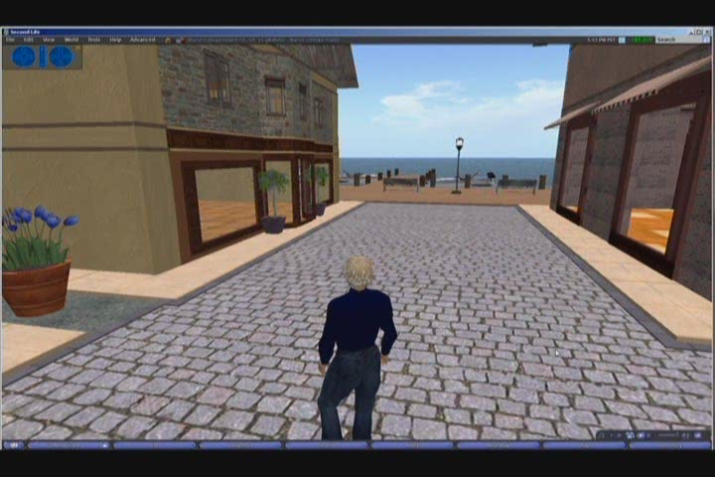
Computer Graphics, Saroj Shakya, Nepal College of Information Technology, Balkumari
‹#›

Slide 12
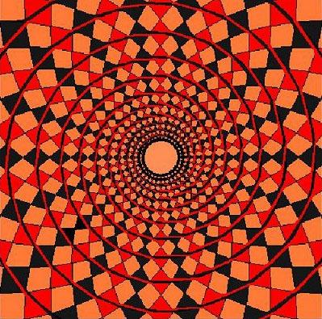
Computer Graphics, Saroj Shakya, Nepal College of Information Technology, Balkumari
‹#›

Slide 13

Computer Graphics, Saroj Shakya, Nepal College of Information Technology, Balkumari
‹#›

Slide 14
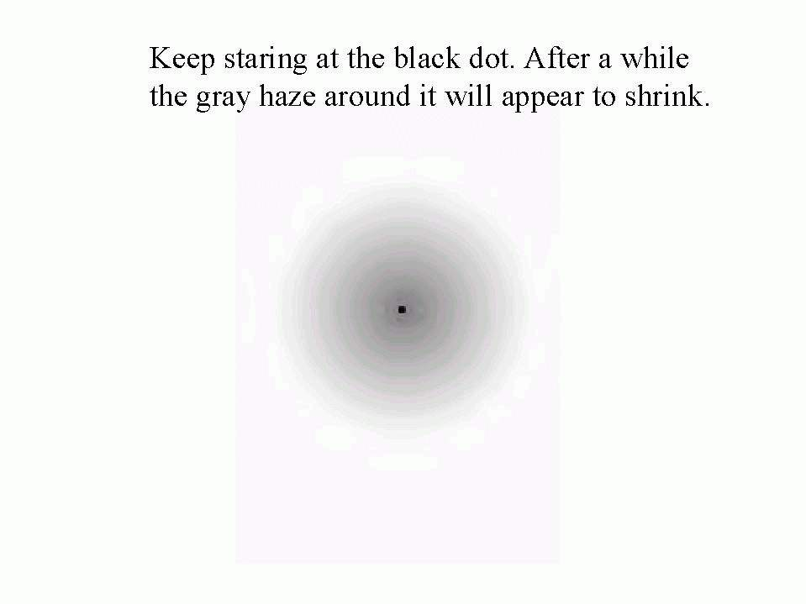
Computer Graphics, Saroj Shakya, Nepal College of Information Technology, Balkumari
‹#›

Slide 15

Computer Graphics, Saroj Shakya, Nepal College of Information Technology, Balkumari
‹#›

Slide 16
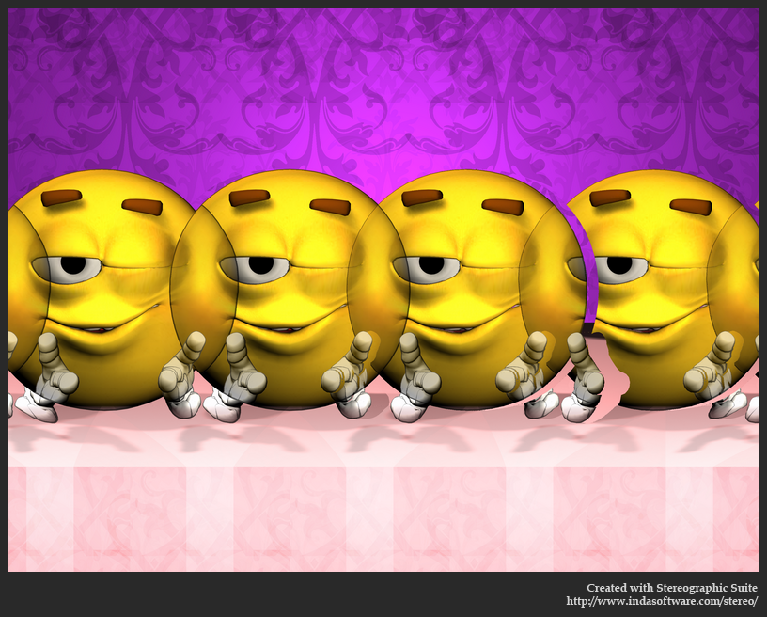
Computer Graphics, Saroj Shakya, Nepal College of Information Technology, Balkumari
‹#›

Slide 17

Computer Graphics, Saroj Shakya, Nepal College of Information Technology, Balkumari
‹#›

Slide 18
Computer Graphics, Saroj Shakya, Nepal College of Information Technology, Balkumari
‹#›

Slide 19
Major components (HW/SW) for computer
graphics
Hardware Components:
monitors, mouse and joy-sticker, and hard-copy devices, e.g. high-resolution color printer
For software Components:
Special purpose utilities (device-dependent and device independent)
needed for handling processing
Computer Graphics, Nepal College of Information Technology, 2009
‹#›

Slide 20
Input Hardware
Tablet
Tablet a tablet is a digitizer.
- scan over an object and input a set of discrete coordinate positions.
These positions can then be joined with straight line segments to approximate the shape of the original object.
A tablet digitizes an object detecting the position of a movable stylus (a pencil shaped device) or a puck(a mouse like device with cross hairs for sighting positions) held in the user’s hand
Computer Graphics, Nepal College of Information Technology, 2009
‹#›

Slide 21
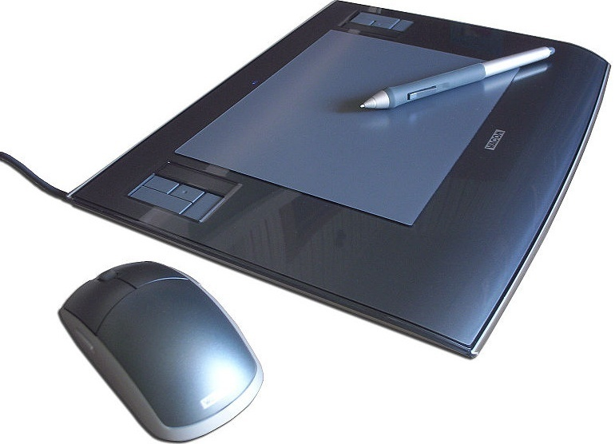
Input Hardware
Computer Graphics, Nepal College of Information Technology, 2009
‹#›

Slide 22
Input Hardware
i. Electrical Tablet
A grid of wires is embedded in the tablet surface
Electromagnetic signals generated by electrical pulses applied in sequence to the wires in the grid induce an electrical signal in a wire coil in the stylus or puck
The strength of the signal induced by each pulse is used to determine the position of the stylus.
The signal strength is also used to determine roughly how far the stylus is from the tablet
Computer Graphics, Nepal College of Information Technology, 2009
‹#›

Slide 23
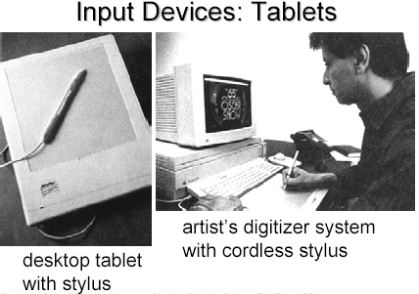
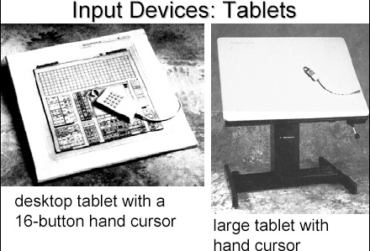
Computer Graphics, Nepal College of Information Technology, 2009
‹#›

Slide 24
Input Hardware
ii. Sonic Tablet
The sonic tablet uses sound waves to couple the stylus to microphones positioned on the periphery of the digitizing area
An electrical spark at the tip of the stylus creates sound bursts.
The position of the stylus or the coordinate values is calculated using the delay between when the spark occurs and when its sound arrives at each microphone
Computer Graphics, Nepal College of Information Technology, 2009
‹#›

Slide 25
Input Hardware
The main advantage of sonic tablet is that it doesn’t require a dedicated working area as the microphones can be placed on any surface to form the tablet work area
This facilitates digitizing drawing on thick books because in an electrical tablet this is not convenient for the stylus can not get closer to the tablet surface
Computer Graphics, Nepal College of Information Technology, 2009
‹#›

Slide 26
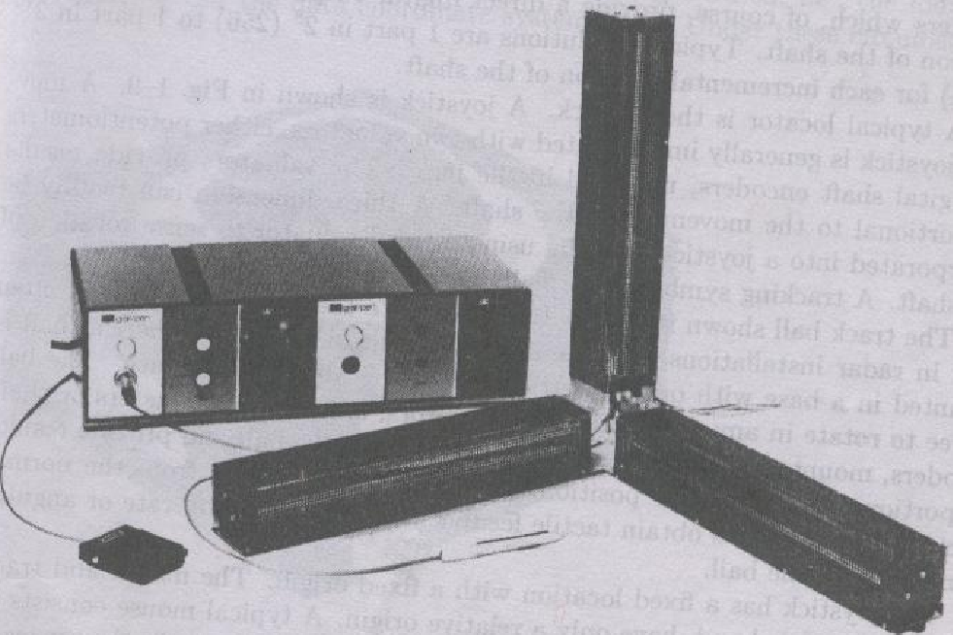
Computer Graphics, Nepal College of Information Technology, 2009
‹#›

Slide 27
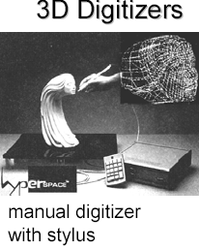
Computer Graphics, Nepal College of Information Technology, 2009
‹#›

Slide 28
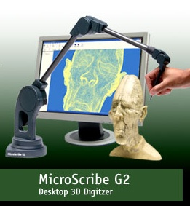
Computer Graphics, Nepal College of Information Technology, 2009
‹#›

Slide 29
Input Hardware
iii. Resistive Tablet
The tablet is just a piece of glass coated with a thin layer of conducting material
When a battery powered stylus is activated at certain position it emits high frequency radio signals which induces the radio signals on conducting layer.
The strength of the signal received at the edges of the tablet is used to calculate the position of the stylus
Computer Graphics, Nepal College of Information Technology, 2009
‹#›

Slide 30
Input Hardware
Several types of tablets are transparent, and thus can be backlit for digitizing x-ray films and photographic negatives.
The Resistive tablet can be used to digitize the objects on CRT because it can be curved to the shape of the CRT.
The mechanism used in the electrical or sonic tablets can also be used to digitize the 3D objects
Computer Graphics, Nepal College of Information Technology, 2009
‹#›

Slide 31
Input Hardware
Touch Panels
The touch panel allows the user to point at the screen directly with a finger to move the cursor around the screen or to select the icons.
i. Optical Touch Panel
It uses a series of infrared light emitting diodes (LED) along one vertical edge and along one horizontal edge of the panel
The opposite vertical and horizontal edges contain photo detectors to form a grid of invisible infrared light beams over the display area.
Computer Graphics, Nepal College of Information Technology, 2009
‹#›

Slide 32
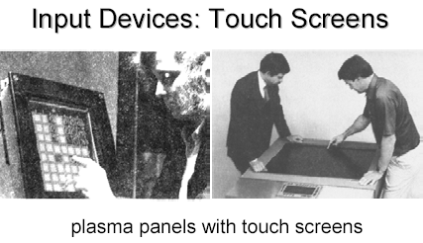
Input Hardware
Touching the screen breaks one or two vertical and horizontal light beams thereby indicating the fingers position
The cursor is then moved to this position or the icon at this position is selected
This is a low resolution panel which offers 10 to 50 positions in each direction
Computer Graphics, Nepal College of Information Technology, 2009
‹#›

Slide 33
Input Hardware
ii. Sonic Touch Panel
Bursts of high frequency sound waves traveling alternately horizontally and vertically are generated at the edge of the panel .
Touching the screen causes part of each wave to be reflected back to its source
The screen position at the point of contact is then calculated using the time elapsed between when the wave is emitted and when it arrives back at the source
This is a high resolution touch panel having about 500 positions in each direction
Computer Graphics, Nepal College of Information Technology, 2009
‹#›

Slide 34
Input Hardware
iii. Electrical Touch Panel
It consists of slightly separated two transparent panel one coated with a thin layer of conducting material and the other with resistive material
When the panel is touched with a finger the two plates are forced to touch at the point of contact thereby creating the voltage drop across the resistive plate which is then used to calculate the coordinate of the touched position
The resolution of the touch panel is similar to that of sonic touch panel
Computer Graphics, Nepal College of Information Technology, 2009
‹#›

Slide 35
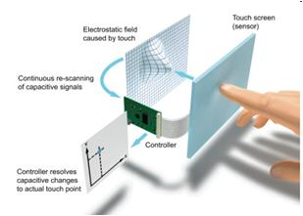
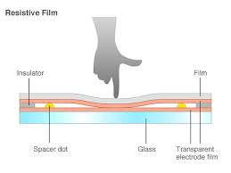
Input Hardware
Computer Graphics, Nepal College of Information Technology, 2009
‹#›

Slide 36
Input Hardware
Light pen
It is a pencil shaped device to determine the coordinates of a point on the screen where it is activated such as pressing the button .
In raster display ‘y’ is set at y_{max} and ‘x’ changes from 0 to x_{max} the first scan line .
For the second line ‘y’ decreases by one and ‘x’ again changes from 0 to x_{max} and so on
When activated light pen sees a burst of light at certain position as the electron beam hits the phosphor coating at that position it generates an electric pulse
Computer Graphics, Nepal College of Information Technology, 2009
‹#›

Slide 37
Input Hardware
This is used to save the video controller’s ‘x’ and ‘y’ registers and interrupt the computer
By reading the saved valued the graphics package can determine the coordinates of the position seen by the light pen
Drawbacks
i. Light pen obscures screen images as it is pointed to required spot
ii. Prolong use of it can cause arm fatigue
iii. It cannot report the coordinates of a point that is completely black as a remedy one can display a dark blue field in place of the regular image for a single frame time
iv. It gives sometimes false reading due to back ground lighting in a room
Computer Graphics, Nepal College of Information Technology, 2009
‹#›

Slide 38
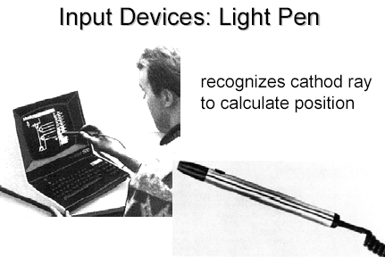
Computer Graphics, Nepal College of Information Technology, 2009
‹#›

Slide 39
Types of Displays:
Emissive Displays
The emissive display converts electrical energy into light energy.
The image is produced directly on the screen Phosphors convert electron beams or UV light into visible light
e.g.: Plasma, Cathode Ray Tube (CRT) Light-Emitting Diode Displays (LED), Plasma Display Panel (PDP)
Non-Emissive Displays
Light is produced behind the screen and the image is formed by filtering this light e.g.: LC-Display (LCD)
The Non emissive display uses optical effects to convert the sunlight or light from any other source to graphic form
Notes:
‹#›

Slide 40
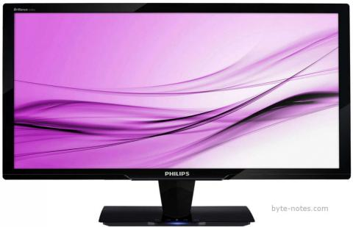
Light Emitting Diode Monitors
Light Emitting Diode (LED) is an improved version of LCD monitor and manufacturers have tried to eliminate the drawbacks of LCD monitors.
They differ in backlighting as LCD monitors use Cold Cathode Fluorescent Light and LED monitors are based on light emitting diode.
The backlighting impacts badly on the image and decreases its sharpness and brightness.
WLED and RGB LED are the two types of LED monitors, depending on the way LED placed in the panel.
Computer Graphics, Nepal College of Information Technology, 2009
‹#›

Slide 41
Benefits of LED over CRT and LCD Monitors
LED monitors give a high-quality image with vibrant colors and viewing comfort.
LCD monitors are unable to display black and white image while LED monitors are capable of producing true black hues.
It consumes less electrical energy than CRT and LCD monitors as a cold cathode fluorescent lamp is embedded in the panel.
The absence of mercury makes it eco-friendly while zero percent flickering removes the chances of strain on the eyes
Computer Graphics, Nepal College of Information Technology, 2009
‹#›

Slide 42
Video Display StandardsVideo Electronics Standards Association (VESA), which consists of video card and monitor manufacturers, develops video stands to define the resolution, number of colors, and other display properties.
Monochrome Display Adapter (MDA)
Hercules Graphics Card
Color Graphics Adapter (CGA)
Enhanced Graphics Adapter (EGA)
Video Graphics Adapter (VGA)
Super VGA (SVGA) and Other Standards Beyond VGA
Computer Graphics, Nepal College of Information Technology, 2009
‹#›

Slide 43
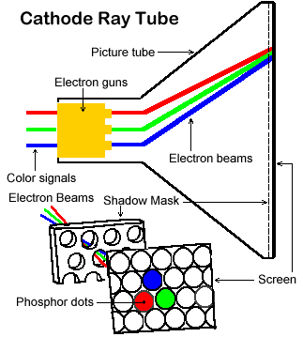
Cathode Ray Tube (CRT)
Notes:
‹#›

Slide 44
LCD (Liquid Crystal Display)
LCD (Liquid Crystal Display)
A type of flat-panel display
Uses liquid crystals between two sheets of material to present information on a screen
An electric current passes through the liquid crystals, they twist
Depending on how much they twist, some light waves are passed through while other light waves are blocked. This creates the variety of color that appears on the screen
Notes:
‹#›

Slide 45
How LCD works?
Step 2. As light passes through liquid crystal, electrical charge causes some of the cells to twist, making light waves bend as they pass through color filter.
Step 1. Panel of fluorescent tubes emits light waves through polarizing glass filter, which guides light toward layer of liquid crystal cells.
Liquid crystal cells
Step 3. When light reaches second polarizing glass filter, light is allowed to pass through any cells that line up at the first polarizing glass filter. Absence and presence of colored light cause image to display on the screen.
Transparent electrodes
Alignment layer
Color filter
Polarizing glass filter
Fluorescent tube panel
Notes:
‹#›

Slide 46
LCD (Liquid Crystal Display)
LCD monitors produce color using either passive-matrix or active-matrix technology
Active-matrix display, also known as a TFT (thin-film transistor) display, uses a separate transistor to apply changes to each liquid crystal cell and thus display high-quality color that is viewable from all angles
Notes:
‹#›

Slide 47
LCD (Liquid Crystal Display)
Passive-matrix display uses fewer transistors and requires less power than an active-matrix display
The color on a passive-matrix display often is not as bright as an active-matrix display
Users view images on a passive-matrix display best when working directly in front of it
Passive-matrix displays are less expensive than active-matrix displays
Notes:
‹#›

Slide 48
LCD (Liquid Crystal Display)
An importance measure of LCD monitors is the response time, which is the time in millisecond (ms) that it takes to turn a pixel on or off
LCD monitors’ response times average 25 ms
The lower the number, the faster the response time
Resolution and dot pitch determines quality of LCD monitor
Notes:
‹#›

Slide 49
Gas plasma monitor
A flat-panel display that uses gas plasma technology
A layer of gas between two sheets of material
When voltage is applied, the gas releases ultraviolet (UV) light that causes the pixels on the screen to glow and form an image
Larger screen sizes and higher display quality than LCD, but much more expensive
Notes:
‹#›

Slide 50
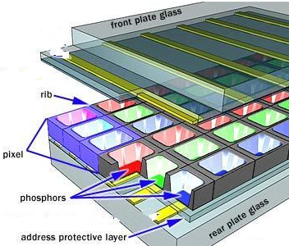
Gas plasma monitor
Notes:
‹#›

Slide 51
ADVANTAGES:
1. Refreshing is not required.
2. Produce a very steady image free of Flicker.
3. Less bulky than a CRT.
DISADVANTAGES:
1. Poor resolution of up to 60 d.p.i.
2. It requires complex addressing and wiring.
3. It is costlier than CRT.
Notes:
‹#›

Slide 52
Hard Copy Devices
Printers
Printed output is referred to as hard copy and do not require electric power as they are printed on papers to read after printing and provide permanent readable form information
According to how they print printers can be of different types:
Character printers prints one character of a text at a time
Line printer prints one line of the text at a time
A page printer prints one page of the text a t a time
Computer Graphics, Nepal College of Information Technology, 2009
‹#›

Slide 53
According to the technology used printers produce output by either impact or non impact methods
Impact printers
Impact printers press the formed character faces against an inked ribbon onto paper
Individual characters or graphics patterns are obtained by retracting certain pins so that the remaining pins form the pattern to be printed.
Non-Impact Printers
Non impact printers use laser techniques, ink-jet sprays etc to get images onto paper.
Computer Graphics, Nepal College of Information Technology, 2009
‹#›

Slide 54
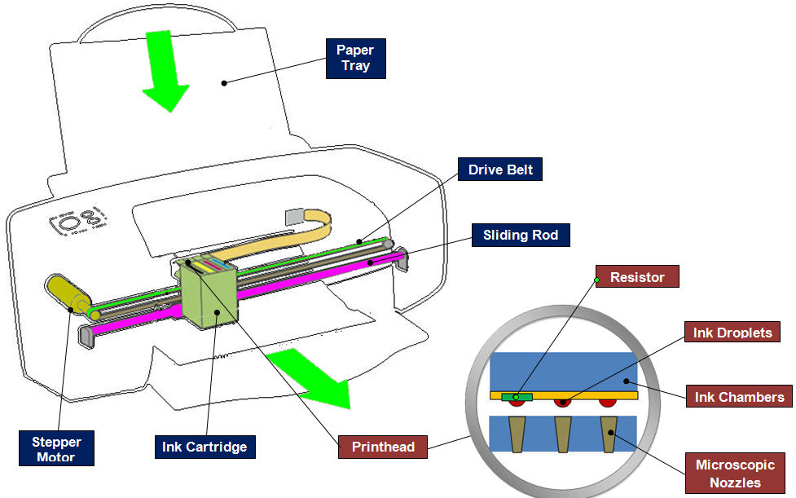
Ink-jet Devices
Ink-jet methods produce output by squirting ink in horizontal rows across a roll of paper wrapped on a drum.
When a heater is activated a drop of ink is exploded onto the paper
Computer Graphics, Nepal College of Information Technology, 2009
‹#›

Slide 55
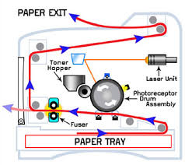
Laser Devices
These are page printers
They use laser beam to produce an image of the page containing text graphics on a photosensitive drum which is coated with negatively charge photo conductive material
In a laser device a laser beam creates a charge distribution on a rotating drum coated with a photo electric material such as selenium. Toner is applied to drum and then transferred to paper.
Computer Graphics, Nepal College of Information Technology, 2009
‹#›

Slide 56
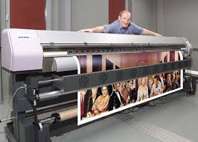
Potters
Plotter is a device that draws pictures on paper based on commands from a computer
They are used to produce precise and good quality graphics and drawing under computers control
They use motor driven ink pen or ink jet to draw graphic or drawings
Drawings can be prepared on paper, Velluym or Mylar (Polyester film)
Computer Graphics, Nepal College of Information Technology, 2009
‹#›

Slide 57
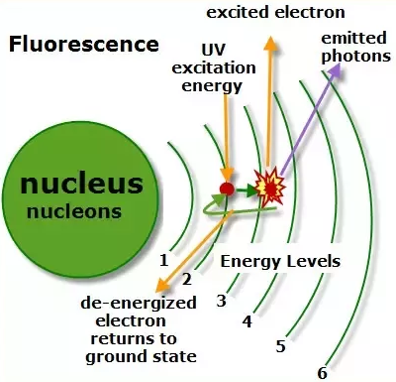
Display Devices
Fluorescence / Phosphorescence
A phosphors fluorescence is the light emitted as the very unstable electrons lose their excess energy whole the phosphor is being struck by electrons
Phosphorescence is the light given off by the return of the relatively more stable excited electrons to their unexcited state once the electron beam excitation is removed
Computer Graphics, Nepal College of Information Technology, 2009
‹#›
Notes:
‹#›

Slide 58
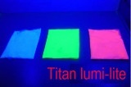
Display Devices
Persistence
A phosphor’s persistence is defined as the time from the removal of excitation to the moment when phosphorescence has decay to 10 percent of the initial light output
The range of persistence of different phosphors can reach many seconds
The phosphors used for graphics display devices usually have persistence of 10 to 60 micro seconds
A phosphor with low persistence is useful for animation and a high persistence phosphor is useful to highly complex static pictures
Computer Graphics, Nepal College of Information Technology, 2009
‹#›

Slide 59

Display Devices
Refresh rate
The refresh rate is the number of times per second the image is redrawn to give a feeling of un-flickering pictures and it is usually 50 per second
As the refresh rate decreases flicker develops because the eye can no longer integrate the individual light impulses coming from a pixel
The refresh rate above which a picture stops flickering and fuses into a steady image is called the critical fusion frequency (CFF)
Computer Graphics, Nepal College of Information Technology, 2009
‹#›

Slide 60
Display Devices
The factors affecting the CFF are:
i. Persistence: longer the persistence the lower the CFF But the relation between the CFF and persistence is non linear
ii. Image intensity: Increasing the image intensity increases the CFF with non linear relationship
iii. Ambient room light Decreasing the ambient room light increases the CFF with nonlinear relationship
iv. Wave lengths of emitted light
v. Observer
Computer Graphics, Nepal College of Information Technology, 2009
‹#›

Slide 61

Display Devices
Resolution
Resolution is defined as the maximum number of points that can be displayed horizontally and vertically with out overlap on a display device
Factors affecting the resolution are as follows
i. Spot profile:
The spot intensity has a Gaussian distribution. So two adjacent spots on the display device appear distinct as long as their separation D₂ is greater than the diameter of the spot D₁ at which each spot has an intensity of about 60 percent of that at the center of the spot
Intensity 60%
D₁
D₂
Computer Graphics, Nepal College of Information Technology, 2009
‹#›

Slide 62
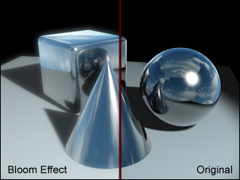
Display Devices
Intensity:
As the intensity of the electron beam increases the spot size on the display tends to increase because of spreading of energy beyond the point of bombardment
This phenomenon is called blooming Consequently , the resolution decreases.
Thus it is noted that resolution is no necessarily a constant and it is not necessarily equal to the resolution of a pix-map, which is allocated in a buffer memory
Computer Graphics, Nepal College of Information Technology, 2009
‹#›

Slide 63
Display Devices
Color CRTs
Color depends on the light emitted by phosphor.
Two type:
Beam Penetration Method
Shadow Mask Method
Computer Graphics, Nepal College of Information Technology, 2009
‹#›

Slide 64
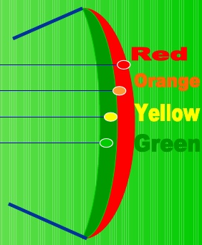
Display Devices
i. Beam Penetration Method:
Two different layers of phosphor coating used Red (outer) and Green
(inner)
Display of color depends on the depth of penetration of the electron beam
into the phosphor layers
A beam of slow electrons excites only the outer red layer
A beam of very fast electrons penetrates thru the red phosphor and excites
the inner green layer
When quantity of red is more than green then color appears as orange
When quantity of green is more than red then color appears as yellow
Screen color is controlled by the beam acceleration voltage.
Only four colors possible, poor picture quality
Computer Graphics, Nepal College of Information Technology, 2009
‹#›

Slide 65
Display Devices
ii. Shadow Mask Method
The inner side of the viewing surface of a color CRT consists of closely spaced groups of red, green and blue phosphor dots.
Each group is called a triad
A thin metal plate perforated with many small holes is mounted close to the inner side of the viewing surface. This plate is called shadow mask
The shadow mask is mounted in such a way that each hole is correctly aligned with a triad in color CRT
Computer Graphics, Nepal College of Information Technology, 2009
‹#›

Slide 66
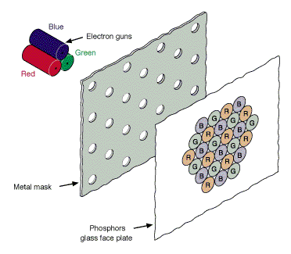
Display Devices
There are three electron guns one for each dot in a triad
The electron beam form each gun therefore hits only the corresponding dot of a triad as the three electron beams deflect
A triad is so small that light emanating from the individual dots is perceived by the viewer as a mixture of the three colors
Thus, a wide range of colors can be produced by each triad depending on how strongly each individual phosphor dot in a triad is excited.
Computer Graphics, Nepal College of Information Technology, 2009
‹#›

Slide 67
Display Devices
a. A Delta –Delta CRT
A triad has a triangular (delta) pattern as are the three electron guns
Main drawback of this type of CRT is that a high precision display is very difficult to achieve because of technical difficulties involved in the alignment of shadow mask holes and the triad on one to one basis
b. Precision Inline CRT
A triad has an in-line pattern as are the three electron guns
The introduction of this type of CRT has eliminated the main drawback of a Delta-Delta CRT
But a slight reduction of image sharpness at the edges of the tube has been noticed
Normally 1000 scan lines can be achieved
Computer Graphics, Nepal College of Information Technology, 2009
‹#›

Slide 68
i. Vector Display Technology
CPU
Peripheral Devices
System Bus
System Memory
Display Processor
Monitor
.
.
MoveTo(10,10)
LineTo(639,479)
.
.
.
Display List ->
Computer Graphics, Nepal College of Information Technology, 2009
‹#›

Slide 69
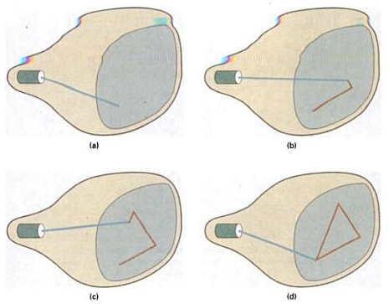
i. Vector Display Technology
Computer Graphics, Nepal College of Information Technology, 2009
‹#›

Slide 70
i. Vector Display Technology
It is also called random scan, a stroke, a line drawing or calligraphic display
Advantages:
i. It can produce a smooth output primitives with higher resolution unlike the raster display technology
ii. It is better than raster display for real time dynamics such as animation
iii. For transformation, only the end points has to be moved to the new position in vector display but in raster display it is necessary to move those end points and at the same time all the pixels between the end points must be scan converted using appropriate algorithm
No prior information on pixels can be reused
Computer Graphics, Nepal College of Information Technology, 2009
‹#›

Slide 71
i. Vector Display Technology
Disadvantages:
i. A vector display can not fill areas with patterns and manipulate bits
ii. Time required for refreshing an image depends upon its complexity (more the lines, longer the time) the flicker may therefore appear as the complexity of the image increases. The fastest vector display can draw about 100000 short vectors in a refresh cycle without flickering
Computer Graphics, Nepal College of Information Technology, 2009
‹#›

Slide 72
ii. Raster Display Technology
CPU
Peripheral Devices
System Bus
System Memory
Video Controller
Monitor
0 0 0 0 0 0 0 0 0 0 0 1 0 0 0 0 0 0 0 0
0 0 1 0 0 0 0 0 0 0
0 0 0 1 0 0 0 0 0 0
0 0 0 0 1 0 0 0 0 0
Frame Buffer ->
Computer Graphics, Nepal College of Information Technology, 2009
‹#›

Slide 73
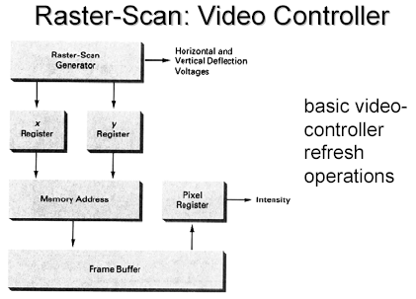
ii. Raster Display Technology
Computer Graphics, Nepal College of Information Technology, 2009
‹#›

Slide 74
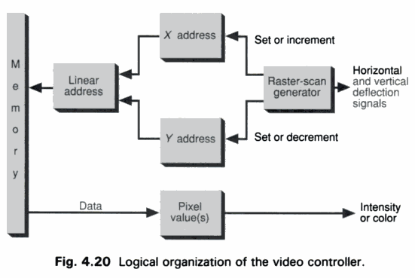
ii. Raster Display Technology
Computer Graphics, Nepal College of Information Technology, 2009
‹#›

Slide 75
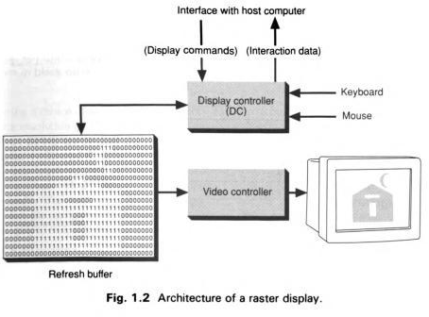
ii. Raster Display Technology
Computer Graphics, Nepal College of Information Technology, 2009
‹#›

Slide 76
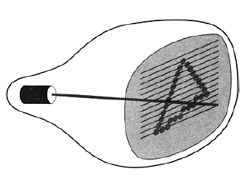
ii. Raster Display Technology
Computer Graphics, Nepal College of Information Technology, 2009
‹#›

Slide 77
ii. Raster Display Technology
Disadvantages
i. For Real-Time dynamics not only the end points are required to move but all the pixels in between the moved end points have to be scan converted with appropriate algorithms which might slow down the dynamic process
ii. Due to scan conversion “jaggies” or “stair-casing” are unavoidable
Computer Graphics, Nepal College of Information Technology, 2009
‹#›

Slide 78
O
Computer Graphics, Nepal College of Information Technology, 2009
‹#›

Slide 79
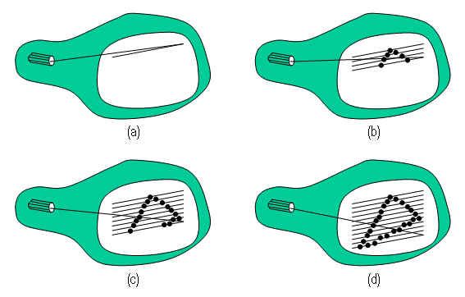
RDT/VDT
Computer Graphics, Nepal College of Information Technology, 2009
‹#›

Slide 80
Frame Buffer
0 0 0 0 0 0 0 0 0 0 0 1 0 0 0 0 0 0 0 0
0 0 1 0 0 0 0 0 0 0
0 0 0 1 0 0 0 0 0 0
0 0 0 0 1 0 0 0 0 0
Screen
0
Electron
Gun
Frame Buffer
Computer Graphics, Nepal College of Information Technology, 2009
‹#›

Slide 81
Frame Buffer
0 0 0 0 0 0 0 0 0 1 0 1 0 0 0 0 0 0 0 0
0 0 1 0 0 0 0 0 0 0
0 0 0 1 0 0 0 0 0 0
0 0 0 0 1 0 0 0 0 0
Screen
1
Electron
Gun
Frame Buffer
Computer Graphics, Nepal College of Information Technology, 2009
‹#›

Slide 82
Frame Buffer
0 0 0 0 0 0 0 0 0 1 0 1 0 0 0 0 0 0 0 0
0 0 1 0 0 0 0 0 0 0
0 0 0 1 0 0 0 0 0 0
0 0 0 0 1 0 0 0 0 0
1
r
Screen
0 0 0 0 0 0 0 0 0 1 0 1 0 0 0 0 0 0 0 0
0 0 1 0 0 0 0 0 0 0
0 0 0 1 0 0 0 0 0 0
0 0 0 0 1 0 0 0 0 0
1
0 0 0 0 0 0 0 0 0 0 0 1 0 0 0 0 0 0 0 0
0 0 1 0 0 0 0 0 0 0
0 0 0 1 0 0 0 0 0 0
0 0 0 0 1 0 0 0 0 0
0
Electron
Guns
Frame Buffer
Computer Graphics, Nepal College of Information Technology, 2009
‹#›

Slide 83
Frame Buffer
0 0 0 0 0 0 0 0 0 1 0 1 0 0 0 0 0 0 0 0
0 0 1 0 0 0 0 0 0 0
0 0 0 1 0 0 0 0 0 0
0 0 0 0 1 0 0 0 0 0
1
r
Screen
0 0 0 0 0 0 0 0 0 1 0 1 0 0 0 0 0 0 0 0
0 0 1 0 0 0 0 0 0 0
0 0 0 1 0 0 0 0 0 0
0 0 0 0 1 0 0 0 0 0
1
0 0 0 0 0 0 0 0 0 1 0 1 0 0 0 0 0 0 0 0
0 0 1 0 0 0 0 0 0 0
0 0 0 1 0 0 0 0 0 0
0 0 0 0 1 0 0 0 0 0
1
Electron
Guns
R G B
1 1 white
0 1 0 green
1 0 0 red
0 0 1 blue
1 1 0 yellow
0 1 1 cyan
0 1 purple
0 0 0 black
Frame Buffer
Computer Graphics, Nepal College of Information Technology, 2009
‹#›

Slide 84
Frame Buffer
Total number of intensities achievable = 2^{n}
out of a single pixel on the screen n = number of
bits assigned to
a single pixel
0 0 0 0 0 0 0 0 0 1 0 1 0 0 0 0 0 0 0 0
0 0 1 0 0 0 0 0 0 0
0 0 0 1 0 0 0 0 0 0
0 0 0 0 1 0 0 0 0 0
0 0 0 0 0 0 0 0 0 1 0 1 0 0 0 0 0 0 0 0
0 0 1 0 0 0 0 0 0 0
0 0 0 1 0 0 0 0 0 0
0 0 0 0 1 0 0 0 0 0
0 0 0 0 0 0 0 0 0 1 0 1 0 0 0 0 0 0 0 0
0 0 1 0 0 0 0 0 0 0
0 0 0 1 0 0 0 0 0 0
0 0 0 0 1 0 0 0 0 0
0 0 0 0 0 0 0 0 0 1 0 1 0 0 0 0 0 0 0 0
0 0 1 0 0 0 0 0 0 0
0 0 0 1 0 0 0 0 0 0
0 0 0 0 1 0 0 0 0 0
0 0 0 0 0 0 0 0 0 1 0 1 0 0 0 0 0 0 0 0
0 0 1 0 0 0 0 0 0 0
0 0 0 1 0 0 0 0 0 0
0 0 0 0 1 0 0 0 0 0
0 0 0 0 0 0 0 0 0 1 0 1 0 0 0 0 0 0 0 0
0 0 1 0 0 0 0 0 0 0
0 0 0 1 0 0 0 0 0 0
0 0 0 0 1 0 0 0 0 0
0 0 0 0 0 0 0 0 0 1 0 1 0 0 0 0 0 0 0 0
0 0 1 0 0 0 0 0 0 0
0 0 0 1 0 0 0 0 0 0
0 0 0 0 1 0 0 0 0 0
1 1 1 1 1 1 1 1
Screen
0 0 0 0 0 0 0 0 0 1 0 1 0 0 0 0 0 0 0 0
0 0 1 0 0 0 0 0 0 0
0 0 0 1 0 0 0 0 0 0
0 0 0 0 1 0 0 0 0 0
0 0 0 0 0 0 0 0 0 1 0 1 0 0 0 0 0 0 0 0
0 0 1 0 0 0 0 0 0 0
0 0 0 1 0 0 0 0 0 0
0 0 0 0 1 0 0 0 0 0
0 0 0 0 0 0 0 0 0 1 0 1 0 0 0 0 0 0 0 0
0 0 1 0 0 0 0 0 0 0
0 0 0 1 0 0 0 0 0 0
0 0 0 0 1 0 0 0 0 0
0 0 0 0 0 0 0 0 0 1 0 1 0 0 0 0 0 0 0 0
0 0 1 0 0 0 0 0 0 0
0 0 0 1 0 0 0 0 0 0
0 0 0 0 1 0 0 0 0 0
Electron
Guns
0 0 0 0 0 0 0 0 0 1 0 1 0 0 0 0 0 0 0 0
0 0 1 0 0 0 0 0 0 0
0 0 0 1 0 0 0 0 0 0
0 0 0 0 1 0 0 0 0 0
0 0 0 0 0 0 0 0 0 1 0 1 0 0 0 0 0 0 0 0
0 0 1 0 0 0 0 0 0 0
0 0 0 1 0 0 0 0 0 0
0 0 0 0 1 0 0 0 0 0
1 1 1 1 1 1 1 1
If n bits are assigned to a single pixel and the resolution of the screen is 1024 x 800 then the total size of the required frame buffer is n x 1024 x 800
Frame Buffer
0 0 0 0 0 0 0 0 0 0 0 1 0 0 0 0 0 0 0 0
0 0 1 0 0 0 0 0 0 0
0 0 0 1 0 0 0 0 0 0
0 0 0 0 1 0 0 0 0 0
0 0 0 0 0 0 0 0 0 1 0 1 0 0 0 0 0 0 0 0
0 0 1 0 0 0 0 0 0 0
0 0 0 1 0 0 0 0 0 0
0 0 0 0 1 0 0 0 0 0
0 0 0 0 0 0 0 0 0 1 0 1 0 0 0 0 0 0 0 0
0 0 1 0 0 0 0 0 0 0
0 0 0 1 0 0 0 0 0 0
0 0 0 0 1 0 0 0 0 0
0 0 0 0 0 0 0 0 0 1 0 1 0 0 0 0 0 0 0 0
0 0 1 0 0 0 0 0 0 0
0 0 0 1 0 0 0 0 0 0
0 0 0 0 1 0 0 0 0 0
0 0 0 0 0 0 0 0 0 1 0 1 0 0 0 0 0 0 0 0
0 0 1 0 0 0 0 0 0 0
0 0 0 1 0 0 0 0 0 0
0 0 0 0 1 0 0 0 0 0
0 0 0 0 0 0 0 0 0 1 0 1 0 0 0 0 0 0 0 0
0 0 1 0 0 0 0 0 0 0
0 0 0 1 0 0 0 0 0 0
0 0 0 0 1 0 0 0 0 0
1 1 1 1 1 1 1 1
‹#›
Computer Graphics, Nepal College of Information Technology, 2009

Slide 85
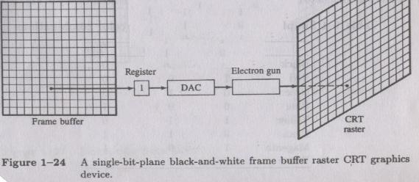
Computer Graphics, Nepal College of Information Technology, 2009
‹#›

Slide 86
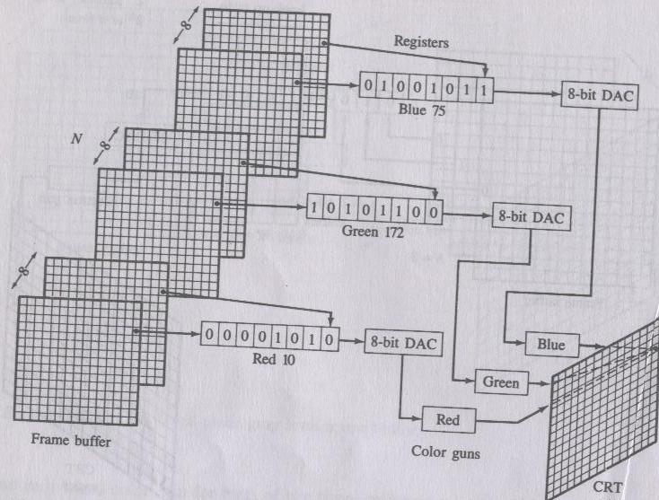
Computer Graphics, Nepal College of Information Technology, 2009
‹#›

Slide 87
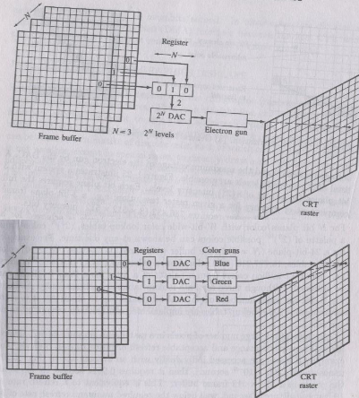
Computer Graphics, Nepal College of Information Technology, 2009
‹#›

Slide 88
0 0 0 0 0 0 0 0 0 1 0 1 0 0 0 0 0 0 0 0
0 0 1 0 0 0 0 0 0 0
0 0 0 1 0 0 0 0 0 0
0 0 0 0 1 0 0 0 0 0
2^{n}
0 0 0 0 0 0 0 0 0 1 0 1 0 0 0 0 0 0 0 0
0 0 1 0 0 0 0 0 0 0
0 0 0 1 0 0 0 0 0 0
0 0 0 0 1 0 0 0 0 0
Intensity
Levels
2^{n} bit DAC
0 0 0 0 0 0 0 0 0 1 0 1 0 0 0 0 0 0 0 0
0 0 1 0 0 0 0 0 0 0
0 0 0 1 0 0 0 0 0 0
0 0 0 0 1 0 0 0 0 0
1
1
1
n
Registers
Electron
Gun
Screen
n
Frame Buffer
The maximum number of intensity
levels achievable from a single pixel
on the screen
2^{n} where n is the number of
bits used to represent that
single pixel
Computer Graphics, Nepal College of Information Technology, 2009
‹#›

Slide 89
Video Cards and CRT Monitors
Many CRT monitors use an analog signal to produce an image
Video card converts digital output from the computer into an analog video signal and sends the signal through a cable to the monitor
Also called a graphics card
Notes:
‹#›

Slide 90
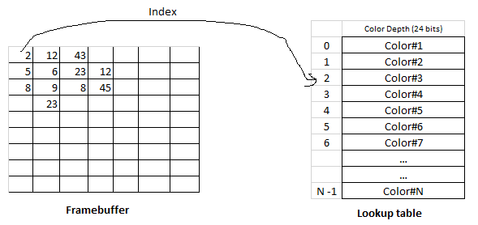
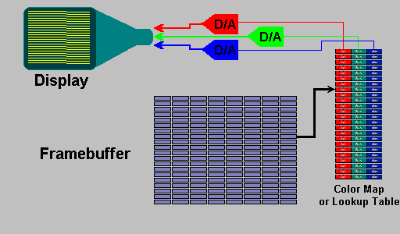
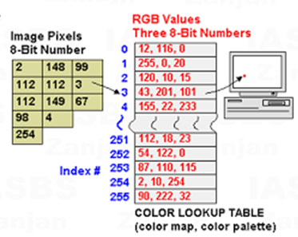
Look up Tables
Notes:
‹#›

Slide 91
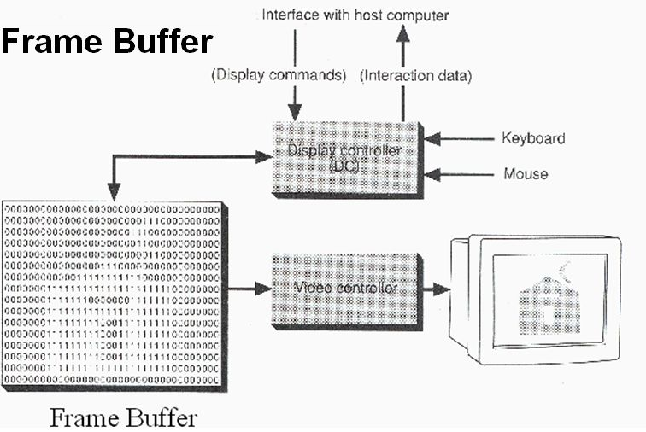
Notes:
‹#›

Slide 92
Video Cards and CRT Monitors
The number of colors a video card displays is determined by its bit depth
The video card’s bit depth, also called the color depth, is the number of bits it uses to store information about each pixel
i.e. 8-bit video card uses 8 bits to store information about each pixel; this video card can display 256 colors (2x2x2x2x2x2x2x2)
i.e. 24-bit video card uses 24 bits to store information about each pixel and can display 16.7 million colors
The greater the number of bits, the better the resulting image
Notes:
‹#›

Slide 93
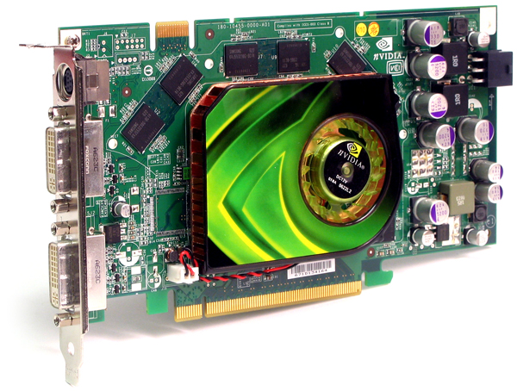
Video Cards and CRT Monitors
Notes:
‹#›

Slide 94
Video Display StandardsVideo Electronics Standards Association (VESA), which consists of video card and monitor manufacturers, develops video stands to define the resolution, number of colors, and other display properties.
Monochrome Display Adapter (MDA)
Hercules Graphics Card
Color Graphics Adapter (CGA)
Enhanced Graphics Adapter (EGA)
Video Graphics Adapter (VGA)
Super VGA (SVGA) and Other Standards Beyond VGA
Computer Graphics, Nepal College of Information Technology, 2009
‹#›

Slide 95
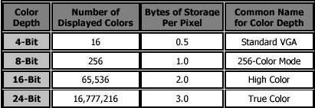
Computer Graphics, Nepal College of Information Technology, 2009
‹#›

Slide 96
Refresh rate
When electron beam strikes a dot in CRT, the surface of the CRT only glows for a fraction of a second and then fades.
Monitor must redraw the picture many times per second to avoid having the screen flicker
Computer Graphics, Nepal College of Information Technology, 2009
‹#›

Slide 97
Refresh rate
The refresh rate is the number of times per second that monitor redraws the images on the screen.
Very few people notice flicker at refresh rates above 72 Hz.
Higher refresh rates are preferred for better comfort in viewing the monitor
Computer Graphics, Nepal College of Information Technology, 2009
‹#›

Slide 98
If the image dimension is 1366 x 768 then what is the size of the image in terms of Mega Pixels Ans: 1 If the image dimension is 2500 x 3192 then what is the size of the image in terms of Mega Pixels Ans: 8

Slide 99
Quality of a CRT Monitor
An RGB raster system is to be designed using an 8-inch by 10-inch screen with a resolution of 100 pixels per inch in each direction. If we want to store 6 bits per pixel in the frame buffer, how much storage (in bytes) do we need for the frame buffer?
The size of frame buffer is (8 x 10 x 100 x 100 x 6)/ 8= 600000bytes
How long would it take to load a 640 by 480 frame buffer with 12 bits per pixel, if 10⁵bits can be transferred per second? How long would it take to load a 24-bit per pixel frame buffer with a resolution of 1280 by 1024 using this same transfer rate?
Total number of bits for the frame = 640 x 480 x 12 bits = 3686400 bits
The time needed to load the frame buffer = 3686400 / 10⁵ sec = 36.864 sec
Total number of bits for the frame = 1280 x 1024 x 24 bits = 31457280 bits
The time needed to load the frame buffer = 31457280 / 10⁵ sec = 314.5728 sec
Computer Graphics, Nepal College of Information Technology, 2009
‹#›

Slide 100
Quality of a CRT Monitor
Assuming that a certain full-color (24-bit per pixel) RGB raster system has a 512-by-512 frame buffer, how many distinct color choices (intensity levels) would we have available? How many different colors could we display at any one time?
Total number of distinct color available is 2²⁴
Total number of colors we could display at one time is 512 x 512
Assuming that a certain RGB raster system has 512*512 frame buffer with 12
bit per pixel
1. How many distinct color choice we have available
2. How many different color could we display at any one time?
Total number of distinct color available is 2²⁴
Total number of different color could display at any one time is 2¹²
The storage spent for frame buffer is 512 X 512 X 12 bit = 3145728 bit
Computer Graphics, Nepal College of Information Technology, 2009
‹#›

Slide 101
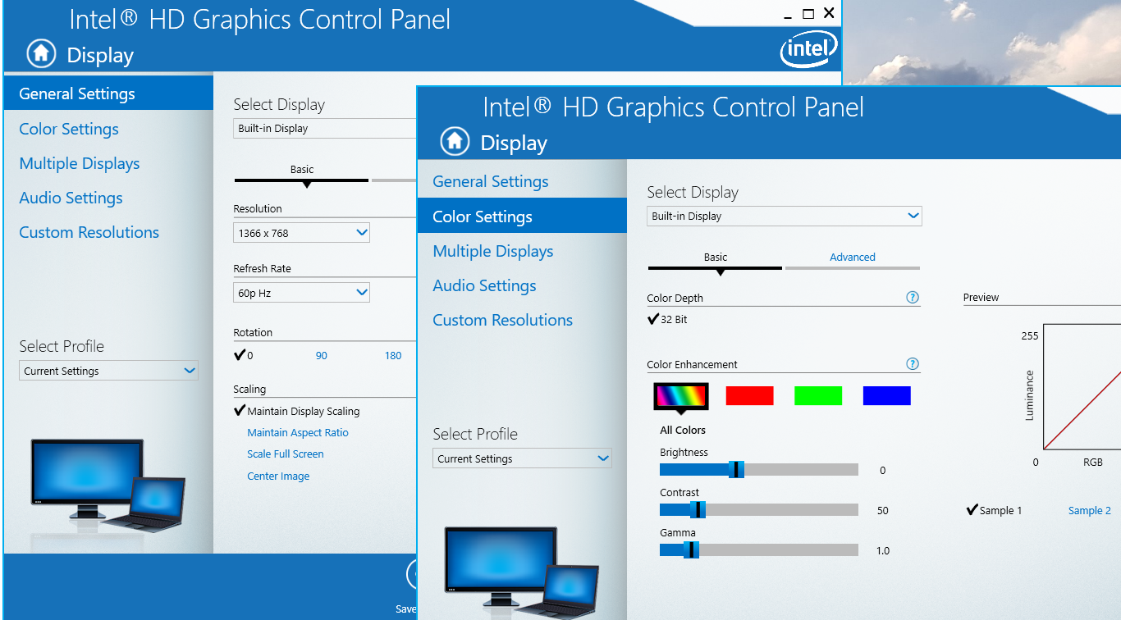
Quality of a CRT Monitor
Computer Graphics, Nepal College of Information Technology, 2009
‹#›

Slide 102
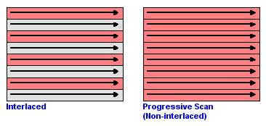
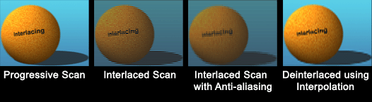
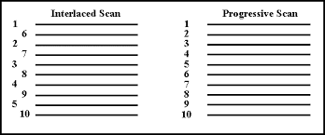


Refresh Rate 60i Hz or 60p Hz
Computer Graphics, Nepal College of Information Technology, 2009
‹#›

Slide 103
Quality of a CRT Monitor
If on an average it takes 20 nanoseconds to glow a single pixel on the screen and the resolution of the screen is 1024 x 800, will there be a flickering effect seen on the screen?
To glow 1 pixel on screen it takes 20 x 10-9 s
T = To glow all pixels on screen it takes 1024x 800 x 20 x 10-9 s
F = 1 / T = 1 / (1024x 800 x 20 x 10-9)
System Refresh rate = 61 frames per sec
Standard refresh rate = 50 frames per sec
There will be no flickering effect seen on the screen as the refresh rate of the screen is 61 fps which is higher than the standard refresh rate!!!
Consider a raster system with resolution of 640 by 480. How many pixels could be accessed per second in this system by a display controller that refreshes the screen at a rate of 60 frames per second? What is the access time per pixel in this system?
The access time per pixel is 1 / (640x480x60)sec
The access time per pixel is 1 / (1280x1024x60)sec
accurate time (1/60 – 639 x T_{horiz} – T_{vert})/640x480 sec
Computer Graphics, Nepal College of Information Technology, 2009
‹#›

Slide 104
Quality of a CRT Monitor
What is the fraction of total refresh time spent in retrace of electron beam for a non interlaced raster system with a resolution of m x n and refresh rate of r Hz , the horizontal retrace time is t_{h} microsecond and vertical retrace time of t_{v} microsecond?
Here ,
The fraction of total refresh time = n x t_{h} + t_{v}
spent in retrace of electron beam 1/r
where t_{h} is horizontal retrace
t_{v} is vertical retrace and r is the refresh rate
n x m = ‘m’ scan lines and ‘n’ pixels in each scan line
Computer Graphics, Nepal College of Information Technology, 2009
‹#›

Slide 105
Quality of a CRT Monitor
Consider a raster system with resolution of 640 by 480. How many pixels could be accessed per second in this system by a display controller that refreshes the screen at a rate of 60 frames per second? What is the access time per pixel in this system?
The access time per pixel is 1 / (640x480x60)sec
The access time per pixel is 1 / (1280x1024x60)sec
Computer Graphics, Nepal College of Information Technology, 2009
‹#›

Slide 106
Quality of a CRT Monitor
A Raster system can produce a total number of 1024 different levels of intensities from a single pixel of a black and white monitor. If the total resolution of the screen is 640 x 480 what will be the required size of frame buffer for the display purpose?
Computer Graphics, Nepal College of Information Technology, 2009
‹#›

Slide 107
Quality of a CRT Monitor
How much time is spent scanning across each row of pixels during screen refresh on a raster system with a resolution of 1280 x 1024 and refresh rate of 60 frames per second.
Here time required to refresh the screen (t) = 1/60 seconds
Computer Graphics, Nepal College of Information Technology, 2009
‹#›

Slide 108
Quality of a CRT Monitor
A Raster system can produce a total number of 1024 different levels of intensities from a single pixel composed of red, green and blue phosphor dots. If the total resolution of the screen is 640 x 480 what will be the required size of frame buffer for the display purpose?
Your mobile phone has a total resolution of 1080x2340 with 409 PPI. What is the display size of your mobile?
Height = 2340/409 in
Width = 1080/409 in
if color depth 24 bit then what is the size of RAM required to display purpose (MB)?
7.3MB
2340
1080
Computer Graphics, Nepal College of Information Technology, 2009
‹#›

Slide 109




Aspect Ratio
The ratio of vertical points to the horizontal points necessary to produce length of lines in both directions of the screen is called Aspect Ratio.
Usually the aspect ratio is ¾.
Computer Graphics, Nepal College of Information Technology, 2009
‹#›

Slide 110
Aspect Ratio
Aspect Ratio TVs
4:3 1.33 : 1 Old TV
16:9 1.77 : 1 HDTVs
21:9 2.35 : 1 Theaters
Computer Graphics, Nepal College of Information Technology, 2009
‹#›

Slide 111
Aspect Ratio
Suppose we have a video monitor with display area that measures 12 inches across and 9.6 inches high. If resolution is 1280 by 1024 what is the aspect ratio and the diameter of each pixel?
Aspect ratio = w/h i.e. 1280/12 / 1024/9.6 = 1
Diameter of each pixel = 12/1280 or 9.6/1024 = 0.0094 inches
Computer Graphics, Nepal College of Information Technology, 2009
‹#›

Slide 112
Quality of a CRT Monitor
Depends largely on its resolution, dot pitch, and refresh rate
Resolution describes the sharpness and clearness of an image
Manufacturers state the resolution of a monitor in pixel
Example: 800 X 600
A pixel (picture element) is a single point in an electronic image
A pixel is the smallest element in an electronic image
Computer Graphics, Nepal College of Information Technology, 2009
‹#›

Slide 113
Line Drawing
Point plotting is accomplished by converting a single coordinate position by an application program into approximate operation for the output device in use.
CRT electron beam is turned on to illuminate the screen phosphor at selected location.
Computer Graphics, Nepal College of Information Technology, 2009
‹#›

Slide 114
Line Drawing
In random scan system, point plotting commands are stored in display list and coordinate values in these instructions are converted to deflection voltages that position the electron beam at that screen location to be plotted during each refresh cycle.
In case of black and white raster scan system a point is plotted by setting the bit value corresponding to specified screen position within frame buffer to 1.
Computer Graphics, Nepal College of Information Technology, 2009
‹#›

Slide 115
Line Drawing
For drawing lines, we need to calculate intermediate positions along the line path between two end points
e.g. 10.45 is rounded off to 10 (this causes stair cases or jaggies to be formed)
To load intensity value into frame buffer at position x, y we use function
setpixel (x, y, intensity)
To retrieve current frame buffer intensity value for specified location we use getpixel(x,y)
4
3
?
2
?
1
1
2
3
4
Computer Graphics, Nepal College of Information Technology, 2009
‹#›

Slide 116
DDA (Digital Differential Analyzer)
Slope intercept equation of a straight line is y = m x +c
For points (x1, y1) and (x2,y2) slope m = y2 – y1/x2 - x1 or Δy/Δx
Algorithms for displaying lines depend on these equations for given interval x we can compute y interval
Δy = m . Δx
‘x’ interval Δx is obtained by Δx = Δy/m
These equations form the basis for determining deflection voltages in analog devices
Computer Graphics, Nepal College of Information Technology, 2009
‹#›

Slide 117
DDA (Digital Differential Analyzer)
For lines with slope m = 1, Δy and Δx are equal
DDA scan conversion algorithm is based on calculating Δx, Δy
We sample line at unit interval in one coordinate and determine corresponding integer values nearest the line path for other coordinate
Computer Graphics, Nepal College of Information Technology, 2009
‹#›

Slide 118
DDA (Digital Differential Analyzer)
Positive Slope
For slope < 1
x > y
y_{k+1} – y_{k} = m
or y_{k+1} = y_{k} + m
y_{k+1}
y
x_{k}
x_{k+1}
Moving from left to right
Computer Graphics, Nepal College of Information Technology, 2009
‹#›

Slide 119
DDA (Digital Differential Analyzer)
Positive Slope
For slope < 1
y > x
x_{k+1} – x_{k} = 1/m
or x_{k+1} = x_{k} + 1/m
y_{k+1}
y_{k}
x_{k}
x_{k+1}
Moving from left to right
Computer Graphics, Nepal College of Information Technology, 2009
‹#›

Slide 120
DDA (Digital Differential Analyzer)
Negative Slope
For slope < 1
y > x
y_{k+1} – y_{k} = m
or y_{k+1} = y_{k} + m
y_{k+1}
y_{k}
x_{k}
x_{k+1}
Moving from left to right
Computer Graphics, Nepal College of Information Technology, 2009
‹#›

Slide 121
DDA (Digital Differential Analyzer)
Negative Slope
For slope > 1
y > x
or x_{k+1} = x_{k} – m ?
y_{k+1}
y_{k}
x_{k}
x_{k+1}
Moving from left to right
Computer Graphics, Nepal College of Information Technology, 2009
‹#›

Slide 122
DDA (Digital Differential Analyzer)
Advantages:
Accurate
Disadvantages :
Slower as it uses floating point arithmetic
Computer Graphics, Nepal College of Information Technology, 2009
‹#›

Slide 123
Bresenham’s Line Drawing Algorithm
Accurate and easier line drawing algorithm by Bresenham
Vertical axis: scan line
Horizontal axis: pixel column
For slope < 1 sample at unit ‘x’ interval in ‘x’ direction, determine which of the two possible pixel positions is closer to the line path at each sample step.
Bresenham’s algorithm gives the solution to this problem by testing the sign of the integer parameter whose value is proportional to difference between the separation of two pixel positions from actual line path.
Computer Graphics, Nepal College of Information Technology, 2009
‹#›

Slide 124

Line Drawing
Computer Graphics, Nepal College of Information Technology, 2009
‹#›

Slide 125
Line Drawing
Algorithm for 0<m<1
Input the two line endpoints and store the left end point in (x₀, y₀)
Load (x₀, y₀) into the frame buffer; that is, plot the first point
Calculate constants Δx, Δy, 2Δy, and 2Δy− 2Δx, and obtain the starting value for the decision parameter as
At each x_{k} along the line, start at k =0, perform the following test:
If p_{k} < 0, the next point to plot is (x_{k}+1, y_{k}) and
Otherwise, the next point to plot is (x_{k}+1, y_{k}+1) and
Repeat step 4 Δx times
Computer Graphics, Nepal College of Information Technology, 2009
‹#›

Slide 126
Dot Pitch
The distance between adjacent sets of red, green and blue dots.
The dot pitch of the monitor indicates how fine the dots are that make up the picture.
The smaller the dot pitch, the more sharp and detailed the image.
Computer Graphics, Nepal College of Information Technology, 2009
‹#›

Slide 127
Filled Area Primitives
Standard output primitive in graphics packages is solid color ,patterned polygon area
Polygons are easier to process due to linear boundaries
Two basic approaches to area filling on a raster system
1. Determine the overlap intervals for scan lines that cross the area.
Typically useful for filling polygons, circles, ellipses
2.Start from a given interior position and paint outwards from
this point until we encounter the specified boundary conditions
useful for filling more complex boundaries, interactive painting
system.
Computer Graphics, Nepal College of Information Technology, 2009
‹#›

Slide 128
Filling rectangles
Two things to consider
i. which pixels to fill
ii. with what value to fill
Move along scan line (from left to right) that intersect the primitive and fill in pixels that lay inside
To fill rectangle with solid color
Set each pixel lying on scan line running from left edge to right with same
pixel value, each span from x _{max} to x _{min}
for( y from y _{min} to y _{max} of rectangle) /*scan line*/
for( x from x _{min} to x _{max} of rectangle) /*by pixel*/
writePixel(x, y, value);
Computer Graphics, Nepal College of Information Technology, 2009
‹#›

Slide 129
Filling Polygons
Filling Polygons
Scan-line fill algorithm
Inside-Outside tests
Boundary fill algorithm
11
1
2
3
4
5
6
7
8
9
10
5
6
7
8
9
4
3
1
2
Computer Graphics, Nepal College of Information Technology, 2009
‹#›

Slide 130
Topological Difference between 2 Scan lines
y : intersection edges are opposite sides
y’ : intersection edges are same side
y
1
2
2
y’
1
1
Computer Graphics, Nepal College of Information Technology, 2009
‹#›

Slide 131
Topological Difference between 2 Scan lines
y : intersection edges are opposite sides
y’ : intersection edges are same side
y
1
2
2
y’
1
1
Computer Graphics, Nepal College of Information Technology, 2009
‹#›

Slide 132
Edge Sorted Table
B
y_{C}
y_{B}
x_{C}
1/m_{CB}
C
C’
E
y_{D}
y_{C’}
x_{D}
1/m_{DC}
y_{E}
x_{D}
1/m_{DE}
D
y_{A}
y_{E}
x_{A}
1/m_{AE}
y_{B}
x_{A}
1/m_{AB}
A
1
Scan-Line Number
0
Computer Graphics, Nepal College of Information Technology, 2009
‹#›

Slide 133
Proceed to Neighboring Pixels
4-Connected
8-Connected
Computer Graphics, Nepal College of Information Technology, 2009
‹#›

Slide 134
Boundary Fill
Start at a point inside a region and paint the interior outward toward the boundary.
If boundary is specified in a single color the fill algorithm proceeds outward pixel by pixel until the boundary color is encountered
Accepts as input coordinates of an interior point (x, y) a fill color and boundary color.
Starting from (x, y) the procedure tests neighboring position to determine whether they are of the boundary color.
If not they are painted with fill color and their neighbors are tested
Process continues until all pixels up to boundary color for the area have been tested
Computer Graphics, Nepal College of Information Technology, 2009
‹#›

Slide 135
boundaryFill ()
Retrive intensity of the pixel inside the boundary
If the retreived intensity is not that of the boundary pixels and AND it is not
the fill color
use recursion to plot pixel in all four directions
Computer Graphics, Nepal College of Information Technology, 2009
‹#›
Notes:
‹#›

Slide 136
boundaryFill(int x,y,fill_color, boundary_color){
int color;
getpixel(x,y,color)
if(color != boundary_color AND color != fill_color ){
setpixel( x,y,fill_color)
boundaryFill( x+1,y,fill_color, boundary_color)
boundaryFill( x,y+1,fill_color, boundary_color)
boundaryFill( x-1,y,fill_color, boundary_color)
boundaryFill( x,y-1,fill_color, boundary_color)
}
}
Computer Graphics, Nepal College of Information Technology, 2009
‹#›
Notes:
‹#›

Slide 137
Flood Fill
Filling an area that is not defined within a single color boundary.
In this case replace a specified interior color instead of searching for boundary color value.
Start from specified interior point (x , y) and reassign all pixel values that are currently set to a given interior color with the desired color.
If the area we want to paint has more than 1 interior color , first assign pixel values so that all interior points have same color.
We can then use 8 or 4 connected approach to move on until all interior points have been repainted.
Computer Graphics, Nepal College of Information Technology, 2009
‹#›

Slide 138
floodFill(int x,y,fill_color, original_color){
int color;
getpixel(x,y,color)
if(color == original_color ){
setpixel(x,y,fill_color)
floodFill(x+1,y,fill_color, original_color)
floodFill(x,y+1,fill_color, original_color)
floodFill(x-1,y,fill_color, original_color)
floodFill(x,y-1,fill_color, original_color)
}
}
Computer Graphics, Nepal College of Information Technology, 2009
‹#›

